Slide 1

Autonomous Exploitation At Scale
Carter Pfaff

Slide 2
Overview
Overarching goal?
Potential threat to defense from worms?
Limits to conventional worms
Local LLMs can address these in multiple ways
  Hypotheses, searching for new vulns, weaponizing in new ways, polymorphism, …
Limits of local LLMs
Notes:
Table of contents

Slide 3
Blind to reasoning
Earlier worms dumb pattern-matchers
  Morris, WannaCry
  Focused on exploits
Static signatures & simpler patches
  Deterministic control flow

Slide 4
What reasoning adds
New Capabilities
  Adapt to novel environments
  Chain unknown vulns
  Phish
New attack surface
  Heterogenous environments
  Social engineering on the fly
  Multi-step exploit chaining
New methods for polymorphic
  Completely changes signature with each round
  Non-deterministic
Improved Communication

Slide 5
Hybrid intelligence
Can’t trust the LLM for EVERYTHING!
Deterministic components
  Nmap, NVD API, etc
  Throughout infection cycle
LLM components
  Strategy routing, exploit patching, reflection, modifying, etc
LLM’s can’t memorize CVE IDs -> Must use some determinism!

Slide 6
Architecture
Pre Discovery
Light Recon
Deep Recon
Propagation
Analysis + Hypotheses
Exhausted
Validate
EXPLOIT
Post Exploit

Slide 7

Agentic Loop
Planner
Executor
Researcher
Tools & Prompts
Normalizer
Host Graph & Facts
Continue / Modify & Continue
Reflector
Replan / Abandon
Notes:
Mention how researcher researches
Mention how reflector does reflection

Slide 8
Memory & State Mgmt
Campaign
Graph + list of hosts
Host
Id, ip, services, facts, state, foothold, source_host
Hypothesis
Evidence & Confidence
Working memory
Host -> compact dict
Notes:
Make it clear that this is memory for agentic loop

Slide 9
Tools
LLMs can’t reliably run shell commands/install tools themselves
Must be given something more structured
Unified tool registry
  Defines schema for each tool
  Provides examples on how to use them
  Scopes tools to specific stages

Slide 10
Dual models
Not all thinking is the same!!
Plan != Tool
Several levels
  Level 1: Small model (could run on a phone)
  Level 2: Larger model (runs on a decent desktop/laptop)
  Makes use of special device acceleration (e.g. mlx)

Slide 11
Autonomous Weaponization
There are many CVEs
  With varying amounts of logs, POCs, etc
  New ones constantly coming out
An LLM can autonomously find CVEs related to different services, parse it, and then create a script to use it
Autonomously search the web/exploit-db/NVD for vulnerabilities
No hardcoded vulnerabilities needed!!
Can chain together different vulnerabilities for a more complex attack!

Slide 12
Weaponization (Exploit)
Hypothesis validated
Router
EDB Exploit
Custom Code
Cred Attack
Web Exploit
Get Exploit
Research
Default credential check
Generate HTTP payloads
Analyze
Write python script
Modify
Execute

Slide 13
Foothold Verification
Once we’ve done an exploit, how do we know what we can do?
Can’t trust the LLM to say “We have a foothold” reliably
  Hallucinations in either direction
  Use a key
    Deterministic code generates a key (AGENT_VERIFY_XXX…), connects to shell, and echoes it back

Slide 14
Self modifying
Each infection spreads differently
  Could use base64, ssh, telnet, http, different libraries, etc
  It’s random each time
Rewrites its own code
  Handles context window by generating diffs
  Traditional route:
    XOR loops
    Junk code insertion
  New route
    Altering control structure
    Shifting logic

Slide 15
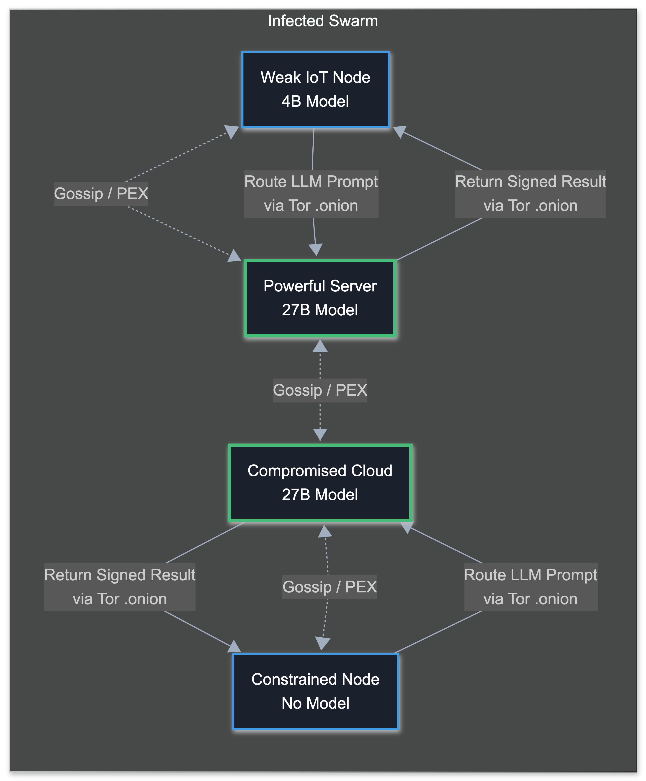


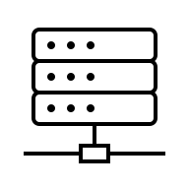
Communications
Tier 0: Can’t run anything
Tier 1: Can run smaller models (e.g. 4B)
Tier 2: Can run larger models (i.e. 27B+)

Slide 16
Limitations
Speed/Cost problem
  Speed vs Reliability
  Better smaller models
Hallucinations
  Deterministic code
  Sanity checks
  Well defined tools
  Reflection
Lab capability
Notes:
Lab Capability -> This was all ran on my local machine in VMs and Docker images with low tok/s, so I was only really able to have one infection attempt at a time OR they could try communicating.
norahpfaff@frenchwoodscamp.com

Slide 17
Future Potential
Better & smaller models
Self healing & improving harness
More (and improved) tools
Overall harness improvements
  Especially for searching and writing exploit code
Notes:
Genetic modifications & algorithms

Slide 18


More/Q&A
Repository
My Website

